Slide 1
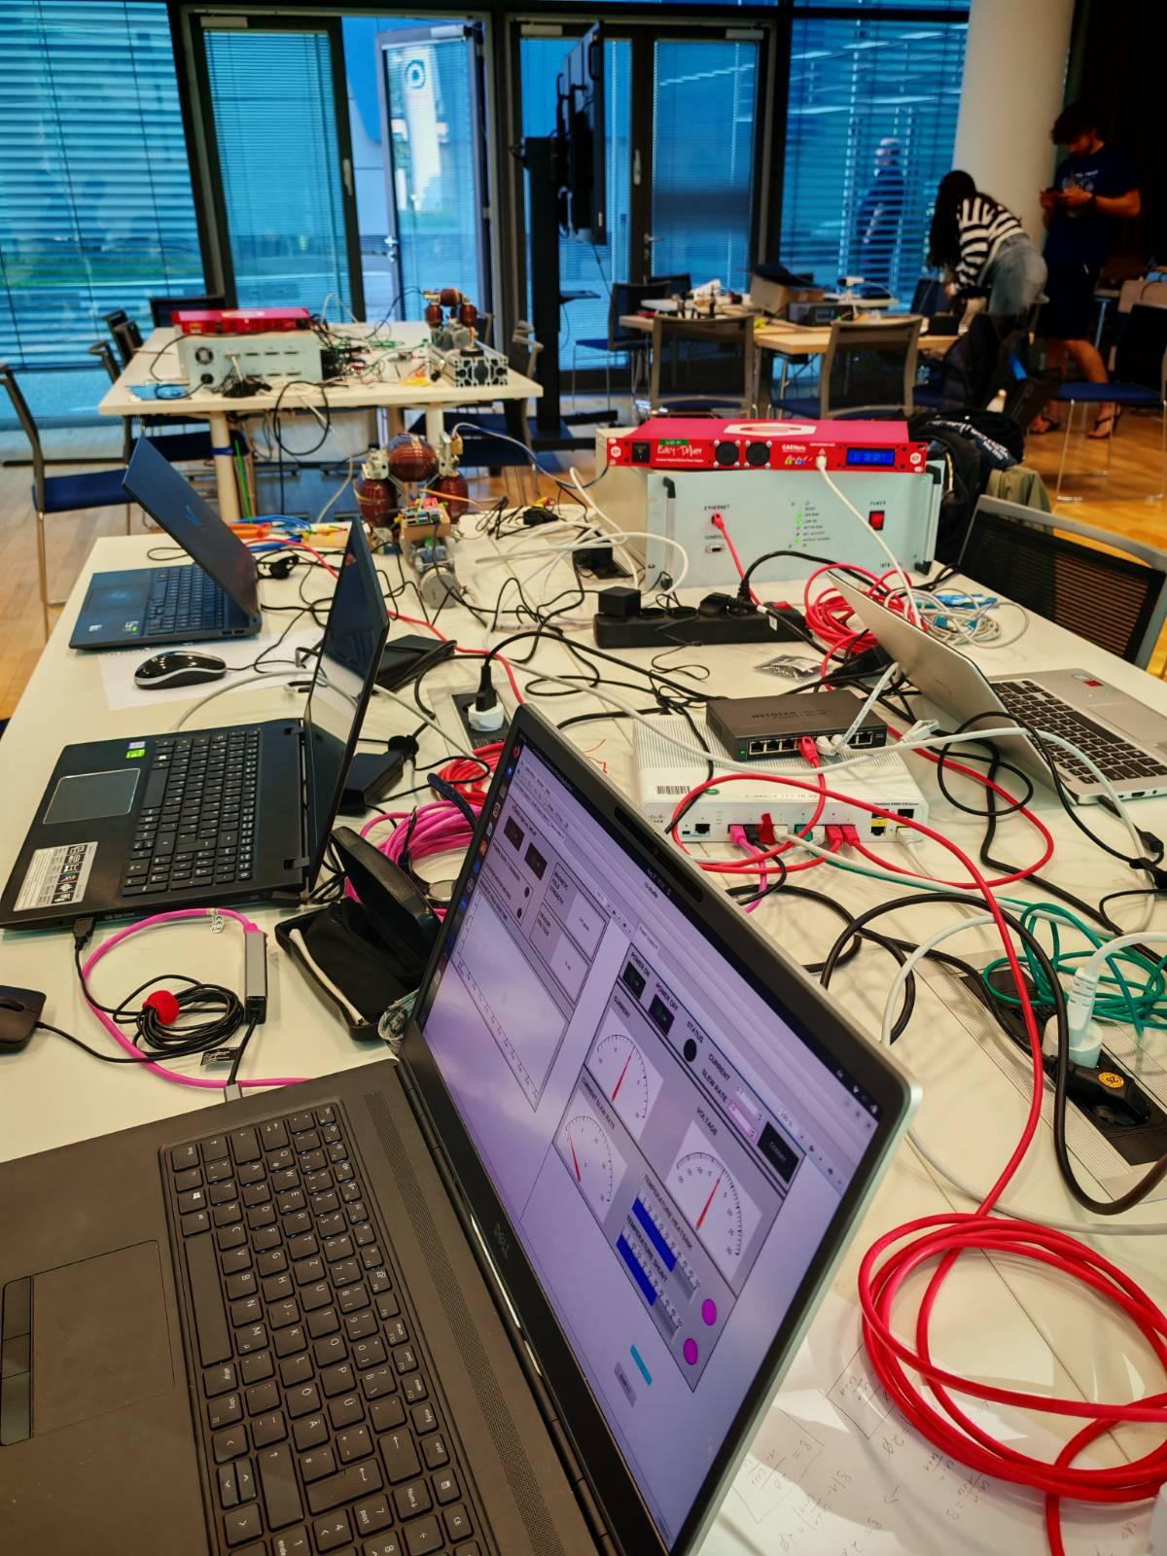
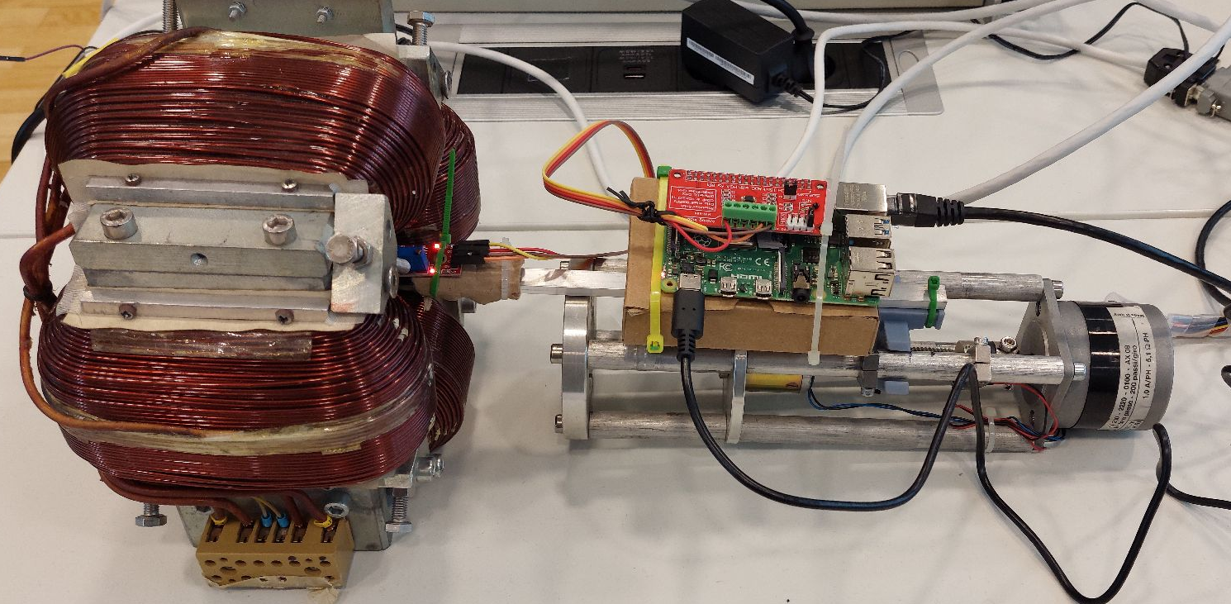
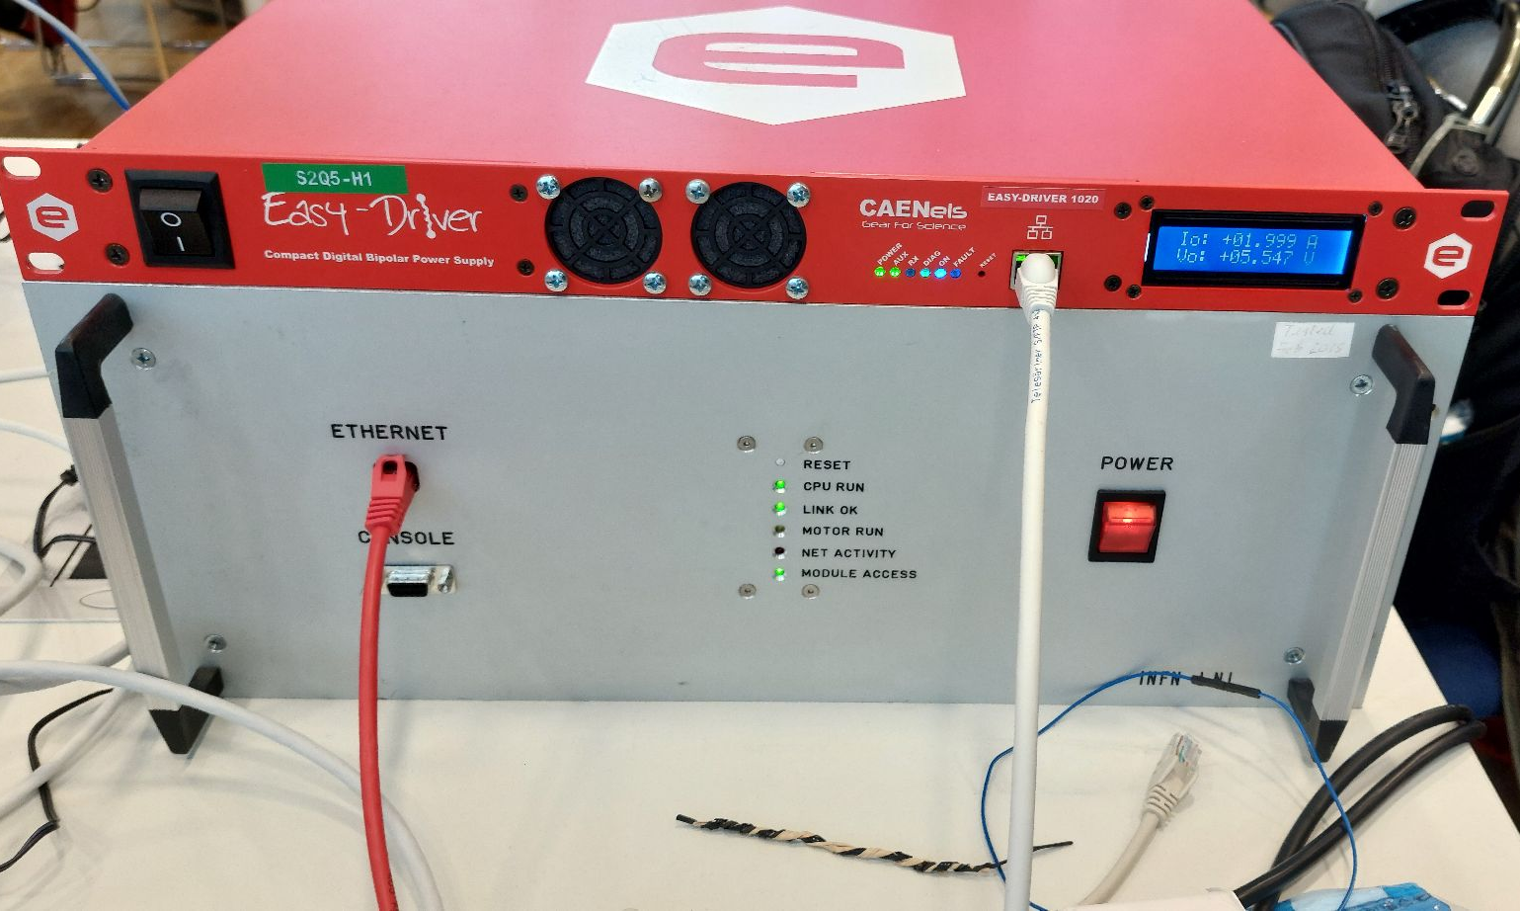
EPIC Magnets 84

Slide 2
01
03
05
Results
Description of the project
Experiment scheme
02
04
Software
Equipment for the experiment (Hardware)
Introduction
T
1
T
Arduino is an open-source electronics platform known for its simplicity and versatility, making it suitable for both beginners and professionals.
Arduino is a key innovation tool, enabling interactive projects in robotics, automation, and IoT. It has democratized technology, empowering hobbyists and engineers through its impact on education and prototyping.

Slide 3
Description of the project
connect hardware develop IOCs for each device create GUI for display and control invent bluesky-script (experiment recipe)
T
1
T
1
What is Arduino

Slide 4
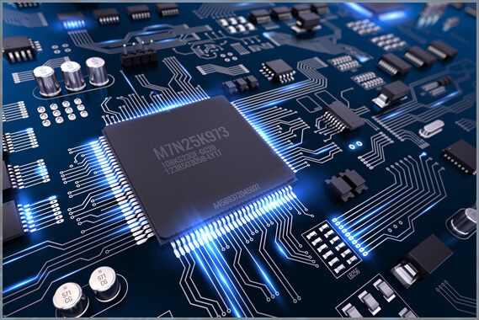

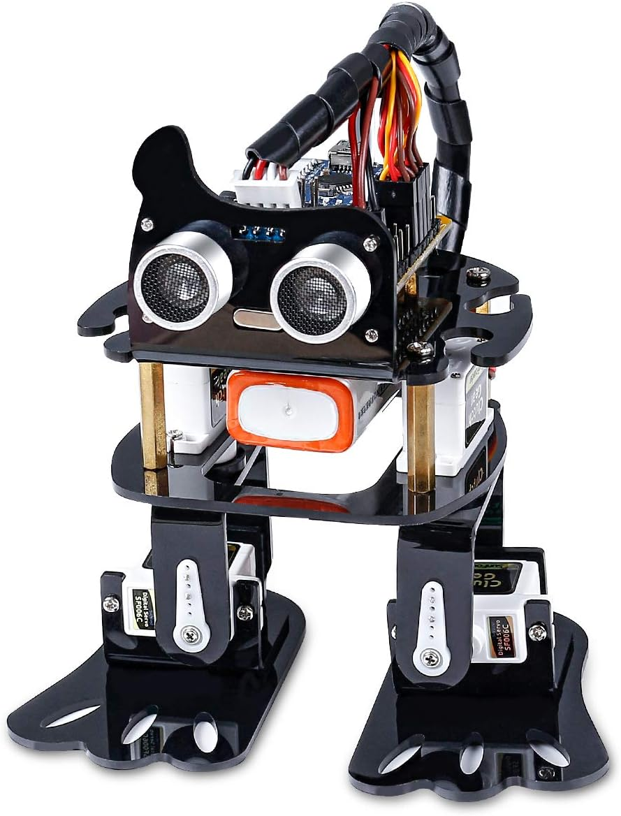
02
Equipment for the experiment (Hardware)
Practical Uses :
Arduino is used in diverse fields such as :
T
2
IoT : Developing smart devices that communicate over the internet.
Electronics : Building circuits and prototypes.
Robotics : Creating robots for tasks like navigation and automation.

Slide 5
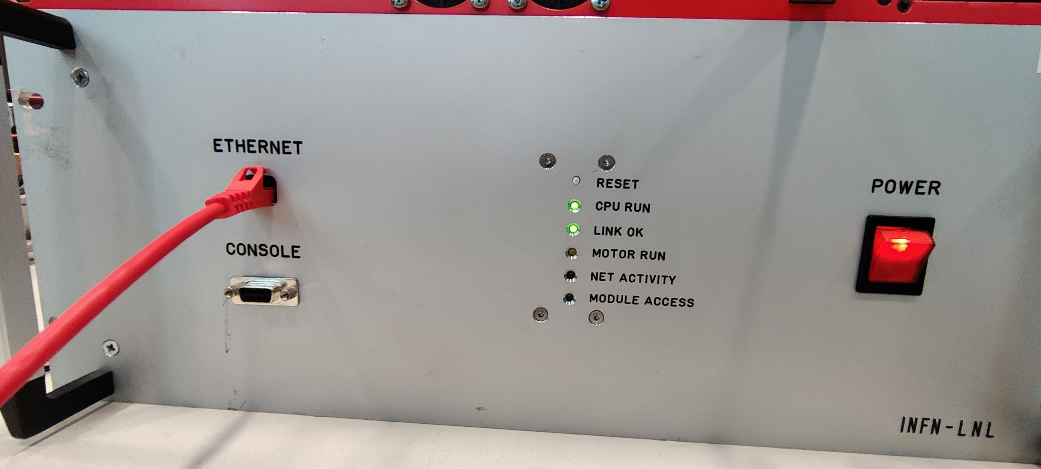
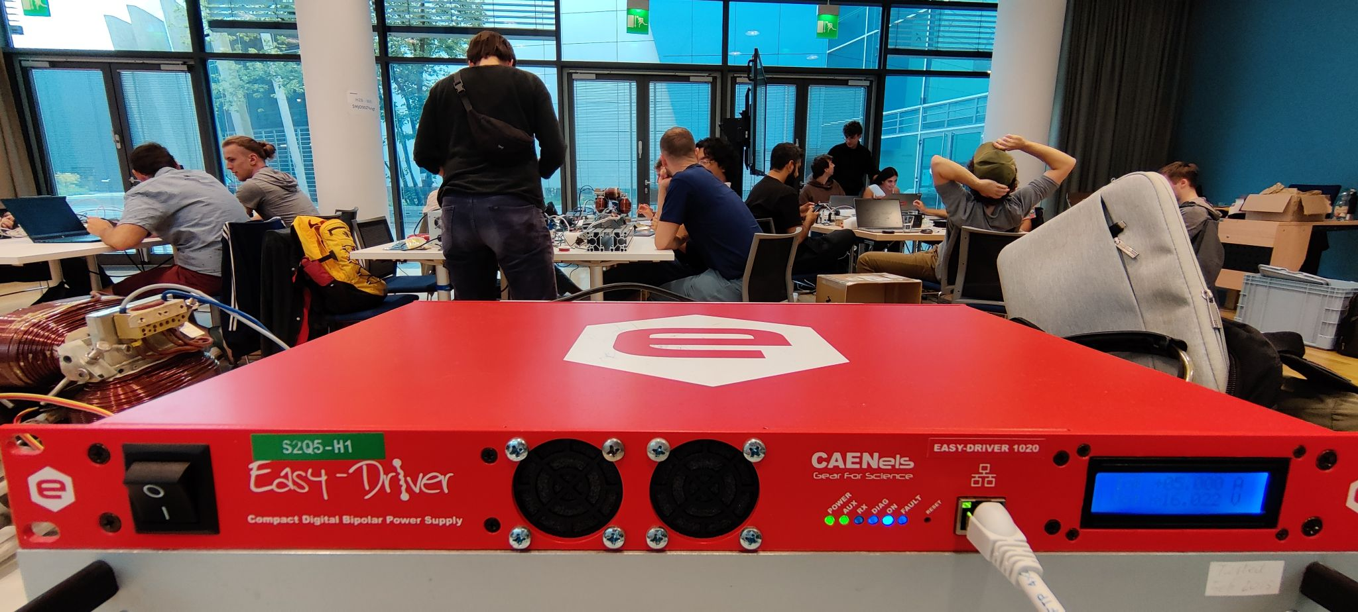
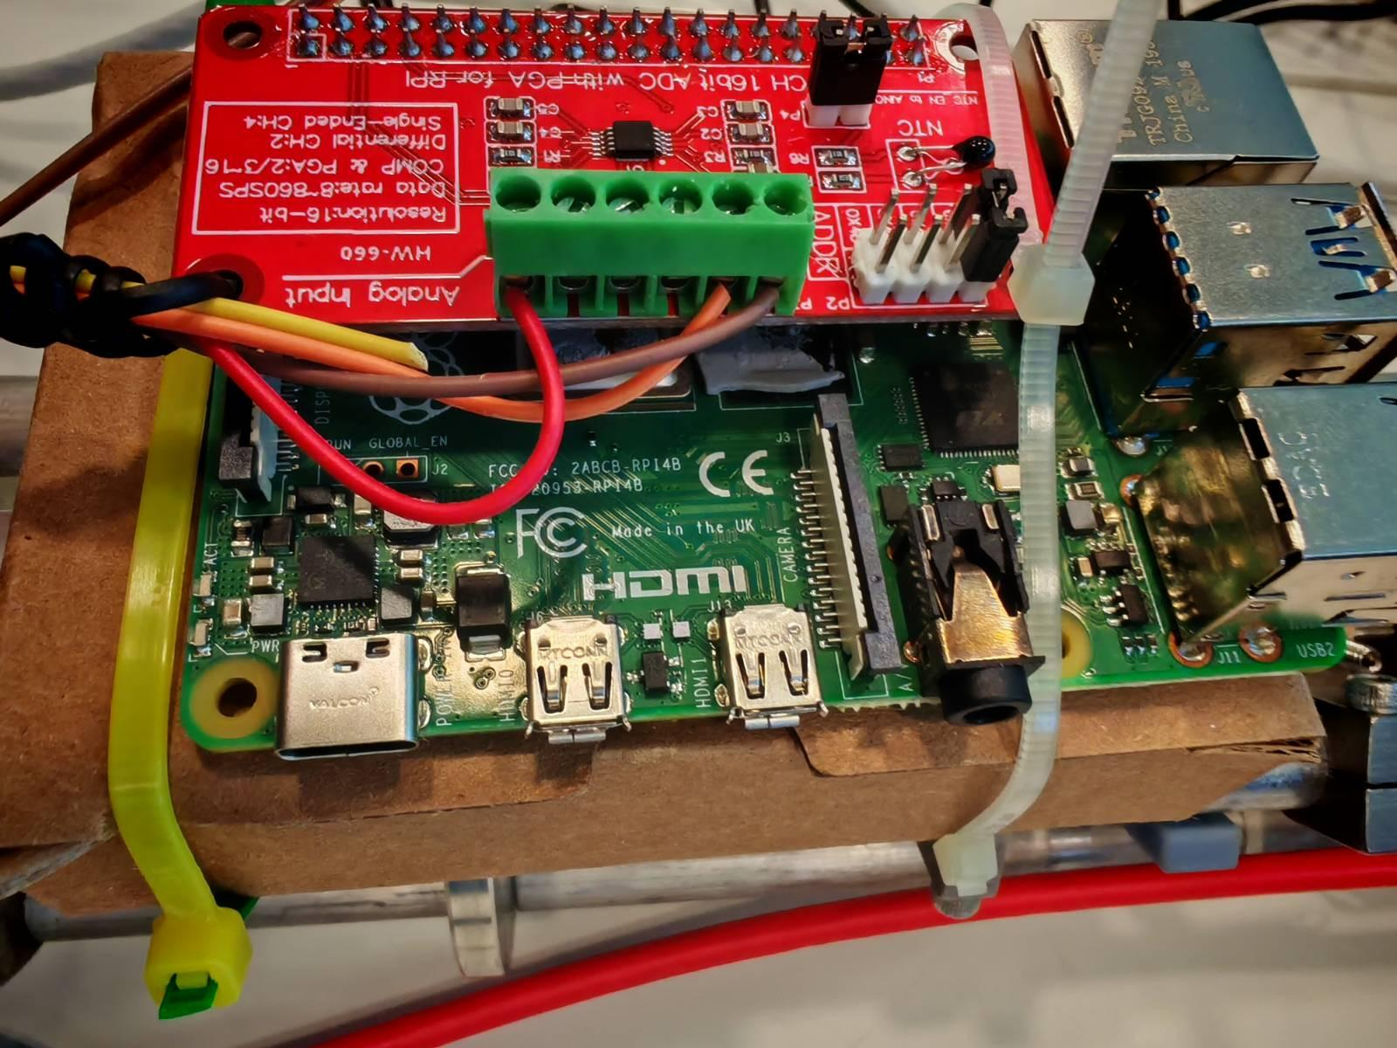
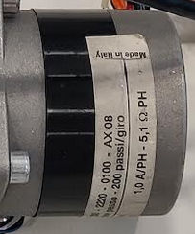
Equipment for the experiment
T
2
Motor & driver
Step angle: 1.8 °; 360 ° = 1 mm
→ 200 steps = 1 mm
Gaussmeter & Raspberry Pi:
measure magnetic field via python-script
Power supply:
Voltage: [-21, 21]
Currente:[-10, 10]
Examples of Projects :
Automated lighting systems.
Weather monitoring stations.
Line-following robots.
Home automation, like controlling appliances remotely.

Slide 6
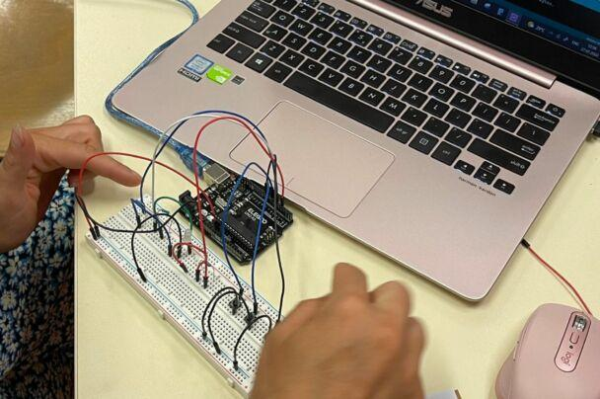
03
Experiment scheme
Microcontroller Overview :
The microcontroller acts as the "brain" of the Arduino, executing programmed instructions.
Input and Output Pins :
Input pins collect data from sensors (e.g., temperature, light).
Output pins control actuators like LEDs, motors, and displays.
Programming Basics :
Arduino uses its own Integrated Development Environment (IDE) where code is written in a simplified version of C/C++. After coding, it is uploaded to the board via a USB cable.
T
3

Slide 7
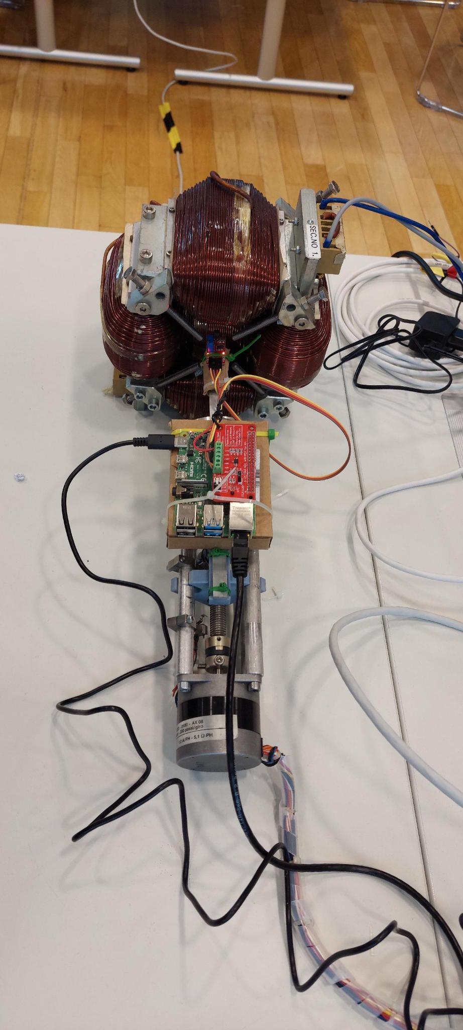
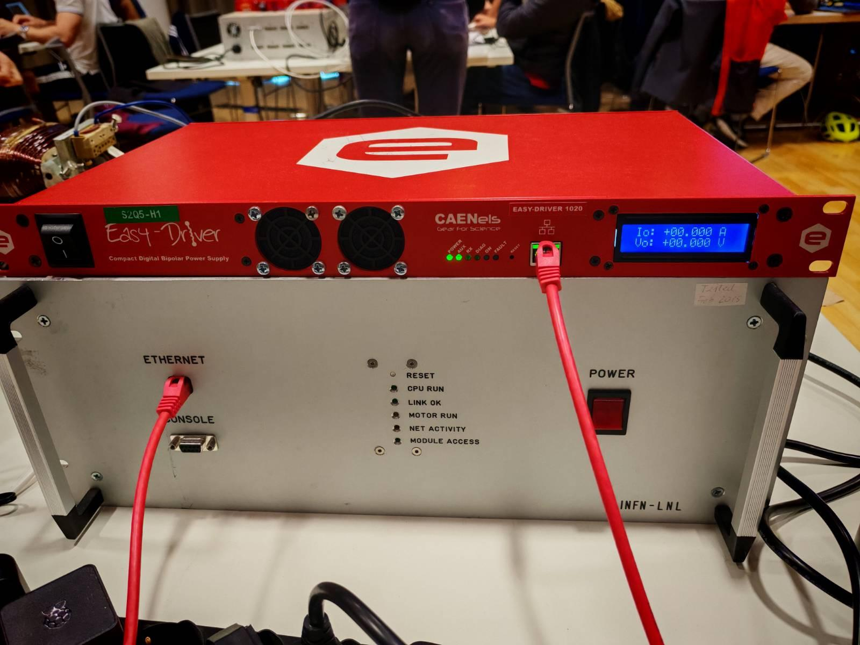
Experiment scheme
T
3
Magnet
Power Supply
Sensor
Raspberry
Motor driver
Motor
Applications of Arduino

Slide 8

Advantages and disadvantages of Arduino
T
5
Notes:
The goal of the project is to control two servo motors using a joystick to convert its movements into precise positions, facilitating control in robotic and automation systems.

Slide 9
04
Software
T
2
What is Arduino :
Arduino is a microcontroller-based platform created in 2005 in Italy to simplify the development of interactive electronic devices. It is low-cost and user-friendly, making it ideal for students and enthusiasts.
Components of an Arduino Board :
Typical components include :
A microcontroller (e.g., ATmega328 on Arduino Uno)
Digital and analog input/output pins
A power jack
A USB interface for programming
Onboard LEDs and reset buttons.
T
4

Slide 10
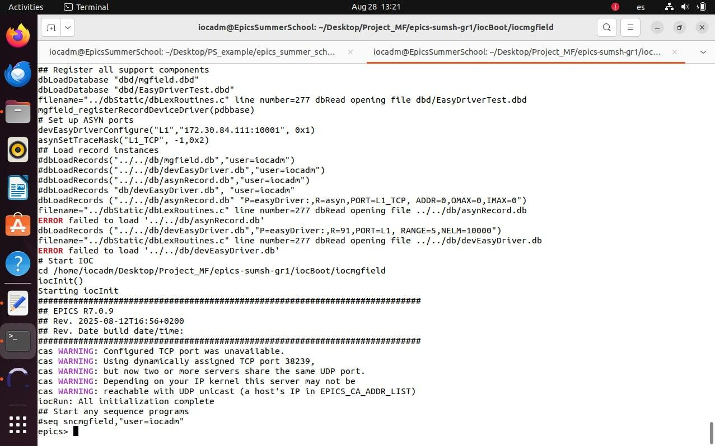
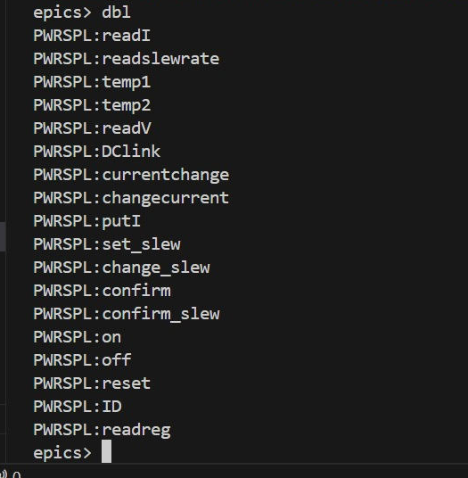
IOC
T
4
Before
After
What are the types of ARDUINO
Notes:
1.Microcontroller : The brain of the board that processes data and executes the code
2. Input/Output Pins : Receive and send digital and analog signals to control sensors and devices.
3. Power Jack : Supplies power to the board from an external source (battery or adapter).
4. USB Interface : Used to program the board, connect it to a computer, and provide power.
5. Onboard LEDs : power status or the execution of operations.
6. Reset Button : Restarts the board to rerun the code from the beginning.

Slide 11
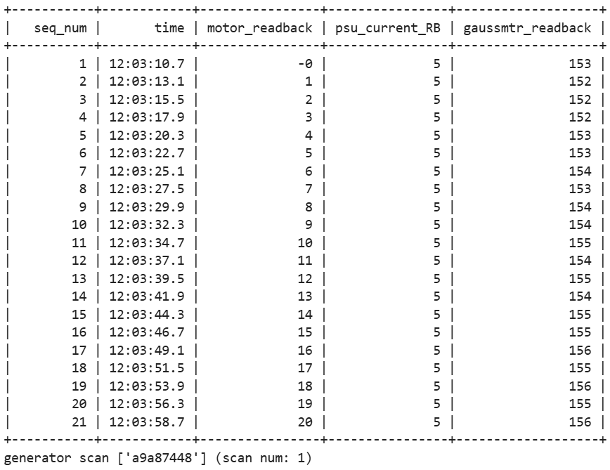
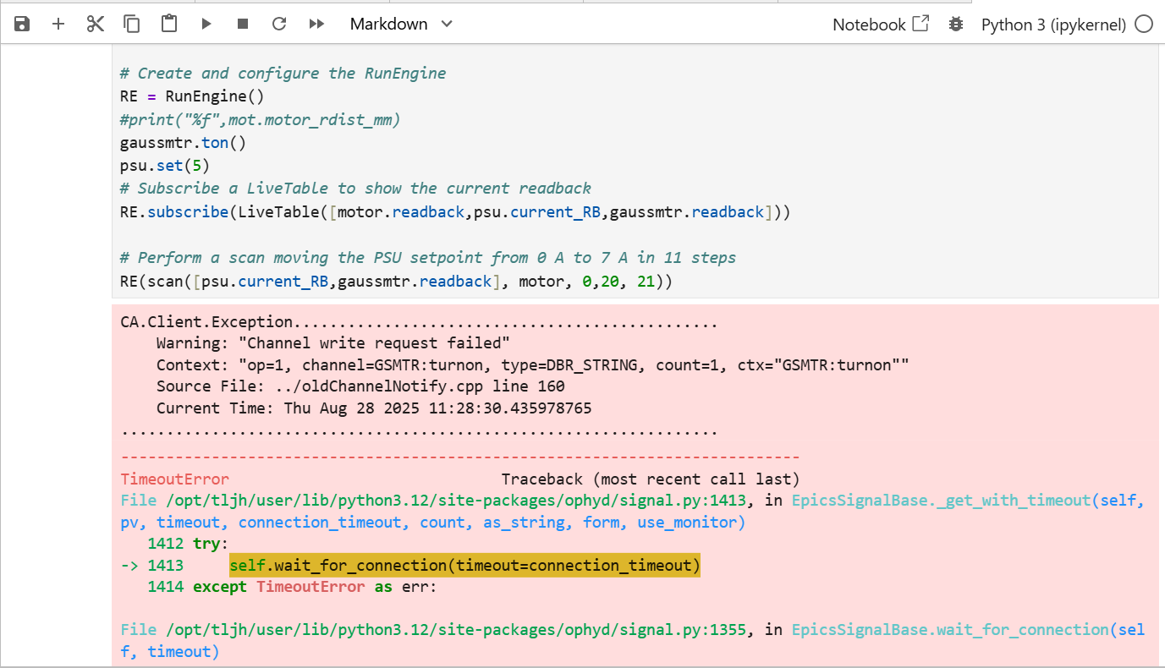
BlueSky
T
4
Before
After
What are the types of ARDUINO
Notes:
1.Microcontroller : The brain of the board that processes data and executes the code
2. Input/Output Pins : Receive and send digital and analog signals to control sensors and devices.
3. Power Jack : Supplies power to the board from an external source (battery or adapter).
4. USB Interface : Used to program the board, connect it to a computer, and provide power.
5. Onboard LEDs : power status or the execution of operations.
6. Reset Button : Restarts the board to rerun the code from the beginning.

Slide 12
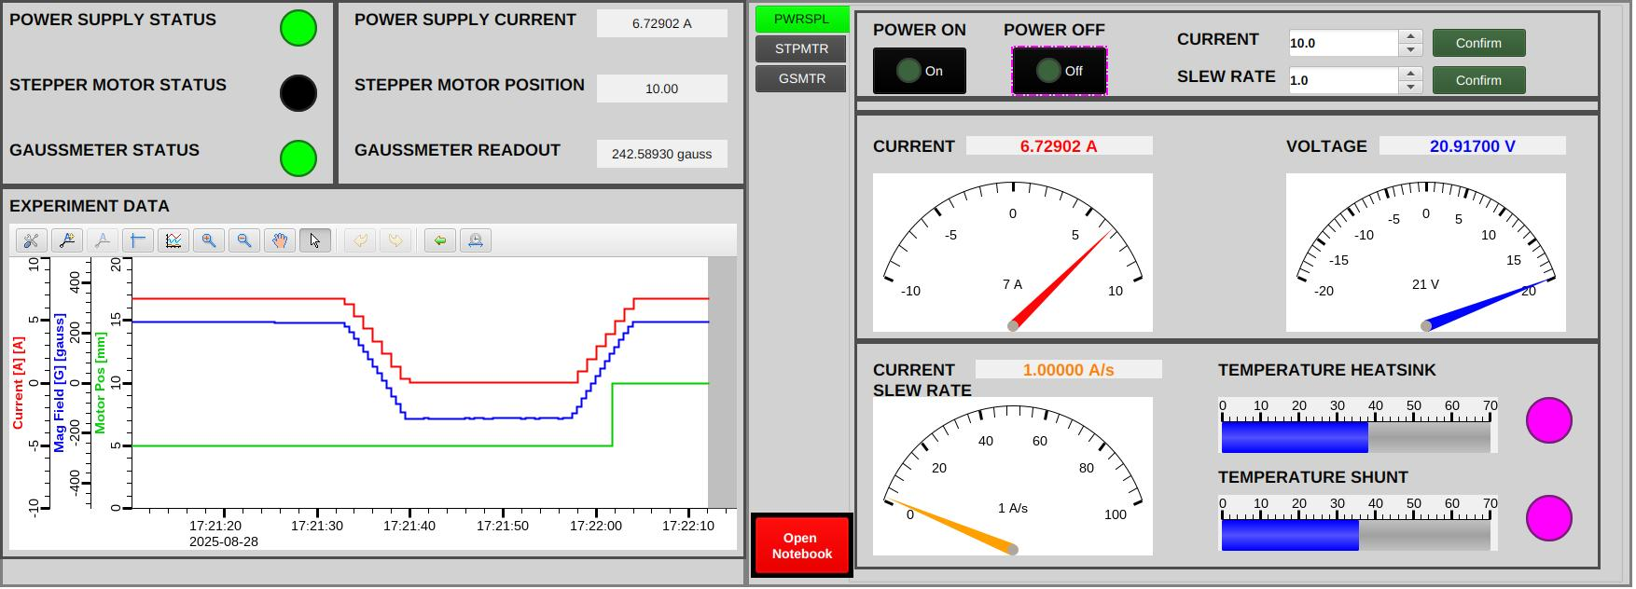
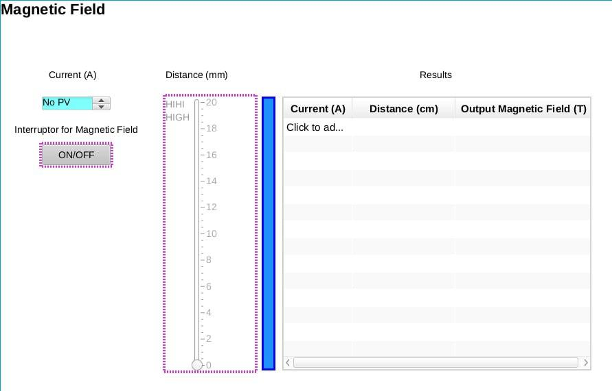
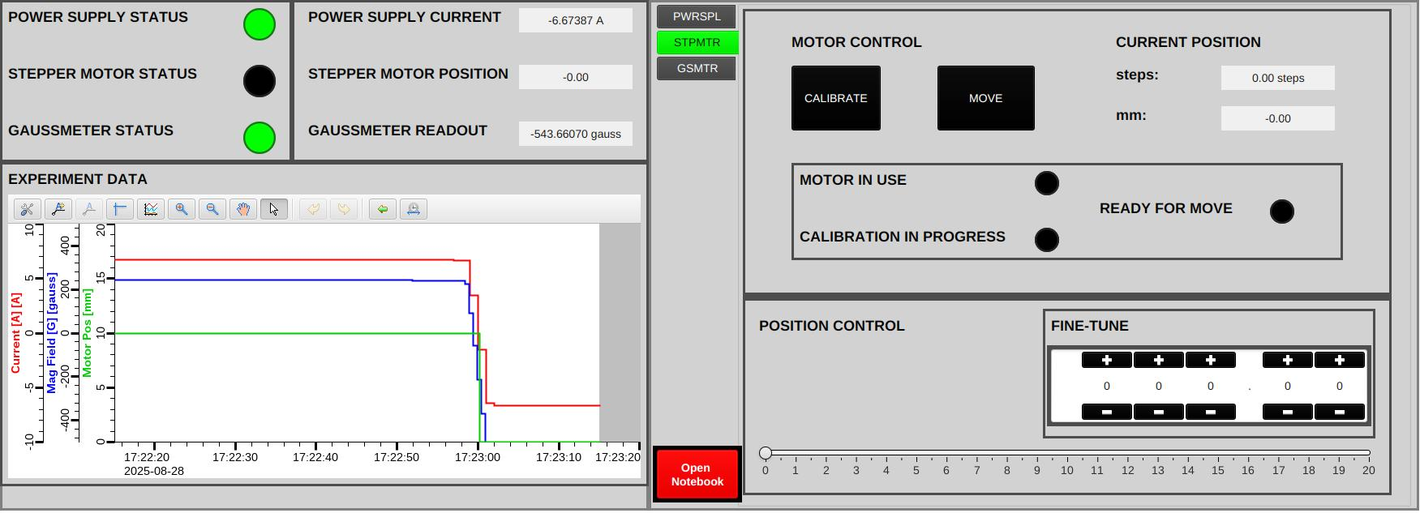
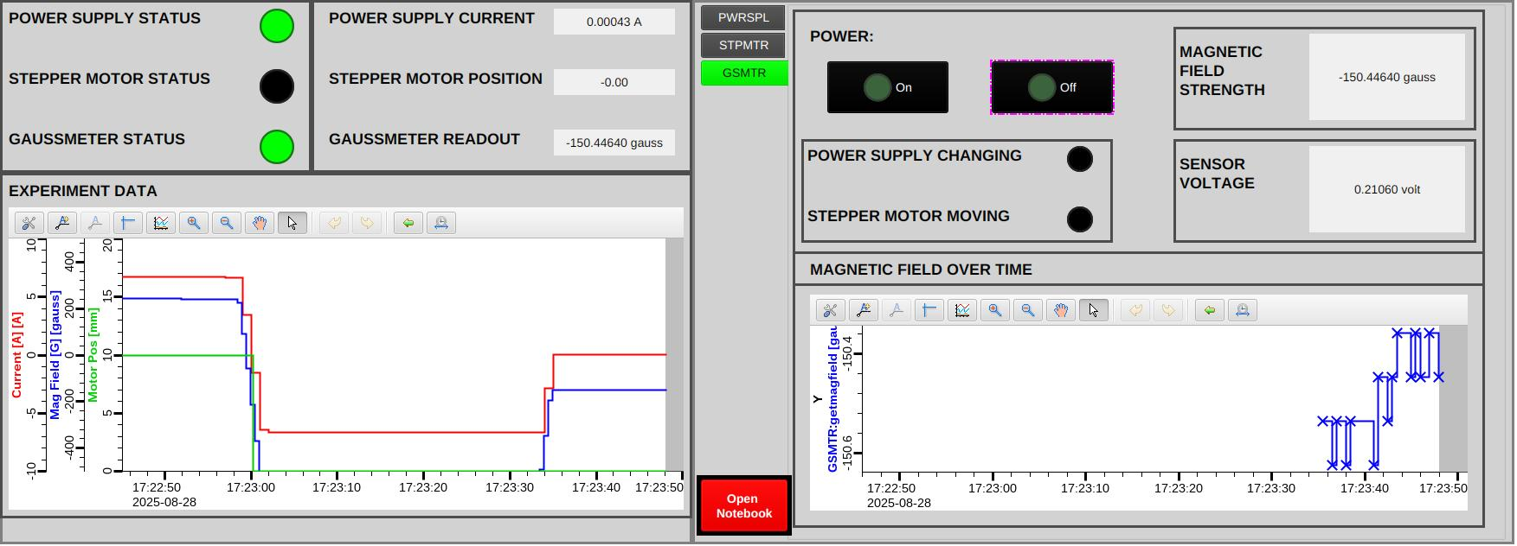
Phoebus
T
Before
After
4
What are the types of ARDUINO
Notes:
1.Microcontroller : The brain of the board that processes data and executes the code
2. Input/Output Pins : Receive and send digital and analog signals to control sensors and devices.
3. Power Jack : Supplies power to the board from an external source (battery or adapter).
4. USB Interface : Used to program the board, connect it to a computer, and provide power.
5. Onboard LEDs : power status or the execution of operations.
6. Reset Button : Restarts the board to rerun the code from the beginning.

Slide 13
Phoebus
T
4
What are the types of ARDUINO
Notes:
1.Microcontroller : The brain of the board that processes data and executes the code
2. Input/Output Pins : Receive and send digital and analog signals to control sensors and devices.
3. Power Jack : Supplies power to the board from an external source (battery or adapter).
4. USB Interface : Used to program the board, connect it to a computer, and provide power.
5. Onboard LEDs : power status or the execution of operations.
6. Reset Button : Restarts the board to rerun the code from the beginning.

Slide 14
Phoebus
T
4
What are the types of ARDUINO
Notes:
1.Microcontroller : The brain of the board that processes data and executes the code
2. Input/Output Pins : Receive and send digital and analog signals to control sensors and devices.
3. Power Jack : Supplies power to the board from an external source (battery or adapter).
4. USB Interface : Used to program the board, connect it to a computer, and provide power.
5. Onboard LEDs : power status or the execution of operations.
6. Reset Button : Restarts the board to rerun the code from the beginning.

Slide 15
Phoebus
T
4
What are the types of ARDUINO
Notes:
1.Microcontroller : The brain of the board that processes data and executes the code
2. Input/Output Pins : Receive and send digital and analog signals to control sensors and devices.
3. Power Jack : Supplies power to the board from an external source (battery or adapter).
4. USB Interface : Used to program the board, connect it to a computer, and provide power.
5. Onboard LEDs : power status or the execution of operations.
6. Reset Button : Restarts the board to rerun the code from the beginning.

Slide 16
05
Results
More pins and memory for complex projects
Most popular and beginner-friendly
Arduino Mega
Arduino Uno
What are the types of ARDUINO
T
5
Arduino Nano
Arduino Micro
Compact for small projects
Small, USB-capable
Arduino MKR Series
Arduino Due
Designed for IoT applications
Powerful 32-bit ARM processor

Slide 17
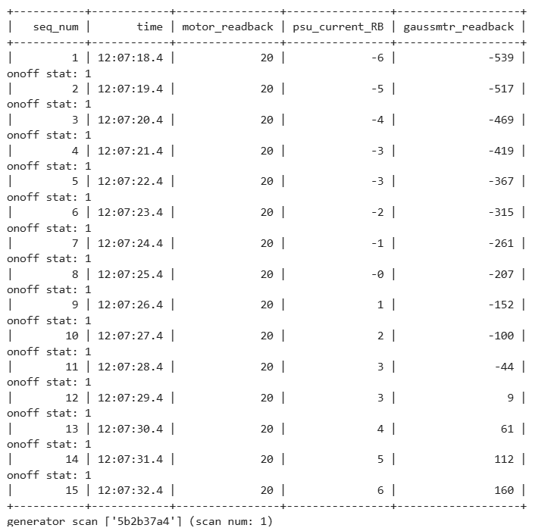

Results
T
5
Different currents
Different distances
What are the types of ARDUINO
Notes:
1.Microcontroller : The brain of the board that processes data and executes the code
2. Input/Output Pins : Receive and send digital and analog signals to control sensors and devices.
3. Power Jack : Supplies power to the board from an external source (battery or adapter).
4. USB Interface : Used to program the board, connect it to a computer, and provide power.
5. Onboard LEDs : power status or the execution of operations.
6. Reset Button : Restarts the board to rerun the code from the beginning.

Slide 18

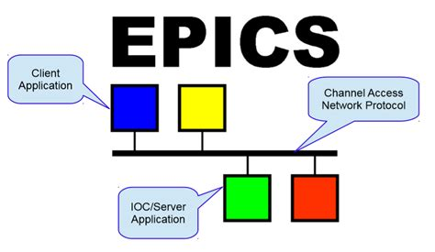








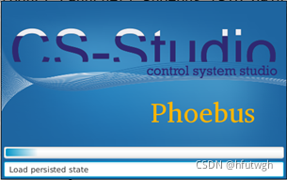
Thanks for your attention

